Slide 1
IBM University Engagement Project
InterviewMate AI
Your Personal AI Interview Trainer
AI-Powered Interview Preparation Platform | IBM Granite + watsonx.ai + RAG
B.Tech Information Technology | IBM watsonx.ai University Engagement
Notes:
Title slide. Project: InterviewMate AI. IBM University Engagement submission using IBM Granite and watsonx.ai.

Slide 2

Student Profile
Student & Project Information
Domain of Project: Education Technology / Artificial Intelligence
Project Title: InterviewMate AI – Your Personal AI Interview Trainer
[Paste Passport
Photo Here]
Student Name: RUPSA DAKAL
Email: dakalrupsa@gmail.com
Mobile / WhatsApp: 7908189875
College: Bengal College of Engineering and Technology
Year / Branch: Final Year B.Tech – IT
InterviewMate AI | IBM watsonx.ai University Engagement
Notes:
Student profile slide. Fill in your real name, email, phone number, and paste your passport photograph.

Slide 3
Problem Statement
Problem Statement
The Challenge
The Objective
Students preparing for technical and HR interviews face several critical problems:
Lack of structured, role-specific practice material
No personalised feedback on their answers
Expensive coaching and limited access to experts
No way to track improvement over time
Generic resources that do not match actual interview formats
Build an AI-powered interview preparation platform that:
Generates fresh, role-specific interview questions using IBM Granite
Evaluates each answer and provides a score out of 10
Gives 6-dimension feedback: correctness, clarity, completeness, strengths, improvements, and a model answer
Saves all sessions in a local database for progress tracking
Uses a RAG knowledge base to ground the AI in domain knowledge
InterviewMate AI | IBM watsonx.ai University Engagement
Notes:
Problem Statement: Students lack structured, personalised interview practice. The objective is to solve this with IBM Granite-powered question generation and answer evaluation.

Slide 4
Proposed Solution
Proposed Solution: InterviewMate AI
InterviewMate AI is a full-stack web application that delivers a complete, personalised interview practice experience end-to-end — from question generation to scored feedback — using IBM Granite and watsonx.ai.
1 SETUP
Student selects job role, interview type, difficulty, and number of questions
2 RAG
Knowledge base retrieves role-specific topics using keyword scoring
3 GENERATE
IBM Granite receives RAG context and generates fresh interview questions
4 ANSWER
Student answers questions with 30-minute timer and progress bar
5 EVALUATE
IBM Granite scores each answer across 6 dimensions with a model answer
-->
-->
-->
-->
OUTCOME: Score /10 | Correctness | Clarity | Completeness | Strengths | Improvements | Model Answer | Dashboard
All sessions, questions, answers, and scores are stored in a local SQLite database. No data is sent to any third party beyond the IBM watsonx.ai evaluation call.
InterviewMate AI | IBM watsonx.ai University Engagement
Notes:
Proposed Solution: The 5-step pipeline — Setup > RAG retrieval > IBM Granite question generation > Student answers > IBM Granite evaluation. Results are persisted in SQLite.

Slide 5
Technology Stack
Technology Stack
IBM watsonx.ai
Cloud AI platform. Provides secure API access to IBM foundation models. Handles IAM authentication, token management, and model deployment.
Model: ibm/granite-3-1-8b-base (Frankfurt EU)
IBM Granite
Foundation language model. Generates interview questions from structured prompts and evaluates candidate answers. Temperature 0.7 for questions, 0.3 for evaluation.
Python Flask
Lightweight web framework. Handles all HTTP routes, Jinja2 template rendering, and error handling. Blueprint architecture separates interview and dashboard routes.
RAG Pipeline
Custom keyword-scoring retrieval from 5 JSON knowledge-base files. No external ML library. Computes precision + density score for every topic item at query time.
SQLite Database
Local embedded database. Stores sessions, questions, answers, and all AI evaluation scores. Auto-migration on startup. No separate server required.
HTML / CSS / JS Frontend
Vanilla stack — no React or Bootstrap. Premium SaaS design with purple-white palette. Includes animated score ring, live progress bar, 30-min timer, and accordion feedback.
InterviewMate AI | IBM watsonx.ai University Engagement
Notes:
Technology stack: IBM watsonx.ai, IBM Granite (ibm/granite-3-1-8b-base), Python Flask, custom RAG pipeline, SQLite, vanilla HTML/CSS/JS frontend.

Slide 6
IBM Granite Integration
IBM Granite & watsonx.ai Integration
Model Used
ibm/granite-3-1-8b-base
Region: Frankfurt (eu-de)
Endpoint: eu-de.ml.cloud.ibm.com
SDK: ibm-watsonx-ai v1.9.0
Class: ModelInference
Auth: IBM IAM (API Key)
Credentials: local .env file only
Generation Parameters
Questions: Temp 0.7, Top-P 0.9, Max 1024 tokens
Evaluation: Temp 0.3, Top-P 0.85, Max 1200 tokens
Lower temperature = more structured output for parsing
How the Prompt is Constructed (Question Generation)
ROLE: Python Developer | TYPE: Technical | DIFFICULTY: Intermediate [ from RAG retriever ]
RELEVANT TOPICS: Python OOP, Decorators, GIL, Generators, Asyncio ...
SAMPLE REFERENCE QUESTIONS: What is a Python decorator? ...
TASK: Generate exactly 5 interview questions for an Intermediate-level Python Developer.
RULES: Number each question. One per line. No answers or hints.
QUESTIONS: [IBM Granite generates here]
Error Handling: Every IBM SDK exception is mapped to a clean project exception
AuthenticationError / InvalidCredentialsError --> GraniteAuthError (shows user a clear message + .env fix hint)
ExceededLimitOfAPICalls --> GraniteAPIError (quota reached message)
ApiRequestFailure / WMLClientError --> GraniteAPIError (retry suggestion)
No fake fallbacks — if Granite is unavailable, the app raises a real error and never substitutes hardcoded scores.
InterviewMate AI | IBM watsonx.ai University Engagement
Notes:
IBM Granite integration details. Model: ibm/granite-3-1-8b-base. Frankfurt region. SDK: ModelInference. Two parameter sets for question generation (creative) vs evaluation (structured). Custom error mapping.

Slide 7
RAG Implementation
RAG – Retrieval-Augmented Generation
RAG means: before asking the AI to generate content, first retrieve relevant information from a knowledge base and inject it into the prompt. This makes the AI's output more accurate and domain-specific.
Knowledge Base (5 JSON Files)
Retrieval Algorithm (Step-by-Step)
java_developer.json
python_developer.json
web_developer.json
data_analyst.json
software_engineer.json
Each file contains:
technical_topics (15 items)
hr_topics (8 items)
sample_questions (beginner / intermediate / advanced)
1. Role Routing
Map role name to JSON file
e.g. Python Developer --> python_developer.json
2. Pool Selection
Technical --> technical_topics
HR --> hr_topics
Mixed --> both pools
3. Query Tokenisation
'Python Developer Technical Intermediate'
--> [python, developer, technical, intermediate]
(stop words removed)
4. Scoring Formula
Precision = matches / query_tokens
Density = matches / sqrt(item_tokens)
Score = (precision + density) / 2
5. Rank + Inject
Top-6 topics and top-4 sample questions injected verbatim into the IBM Granite prompt as structured context.
InterviewMate AI | IBM watsonx.ai University Engagement
Notes:
RAG pipeline: 5 JSON knowledge-base files, one per role. Keyword-scoring retriever (no vector DB or external ML library). Scoring: precision + density formula. Top-6 topics + top-4 samples injected into prompt.

Slide 8
System Architecture
System Architecture Diagram
FRONTEND LAYER
HTML / CSS / JavaScript
index.html | setup.html | interview.html | results.html | dashboard.html
style.css (purple-white SaaS) | interview.js (timer, progress bar, guard)
HTTP Requests / Jinja2 Responses
BACKEND LAYER – Python Flask (app.py)
routes/interview.py : GET / | GET /setup | POST /generate | GET /interview/<id> | POST /submit/<id> | GET /results/<id>
routes/dashboard.py : GET /dashboard
config.py (reads .env, validates credentials + detects placeholders)
RAG context
API calls / responses
SERVICES LAYER
rag_service.py
(keyword scoring, JSON KB)
DATABASE
database/db.py
SQLite interviewmate.db
IBM CLOUD
granite_service.py
ibm-watsonx-ai SDK
ModelInference
ibm/granite-3-1-8b-base
Knowledge Base
5 x .json files
java / python / web
data / software
SQLite File
interviewmate.db
sessions + questions
answers + scores
IBM IAM
eu-de.ml.cloud.ibm.com
API Key authentication
Frankfurt region
InterviewMate AI | IBM watsonx.ai University Engagement
Notes:
System architecture: 4-layer design. Frontend (HTML/CSS/JS) communicates with Flask backend. Backend delegates to RAG service (local JSON KB), DB service (SQLite), and Granite service (IBM Cloud via SDK).

Slide 9
Data Flow Diagram
End-to-End Data Flow
QUESTION GENERATION FLOW
Student fills
Setup Form
(role, type,
difficulty, count)
RAG Service
Loads JSON KB
Scores & ranks
topics by keyword
IBM Granite
Receives prompt
+ RAG context
Generates Qs
Flask saves
session +
questions
to SQLite
POST /generate
context_str
question list
redirect to /interview/<id>
ANSWER EVALUATION FLOW
Student
submits
answers
(text form)
RAG Service
get_evaluation
_context()
for each Q
IBM Granite
evaluate_answer()
SCORE + 6
feedback fields
SQLite
save_answer()
complete_session()
avg_score = AVG
POST /submit/<id>
domain ctx
evaluation dict
Results Page: Score ring | Per-question accordion | Feedback grid | Model answers | Dashboard link
InterviewMate AI | IBM watsonx.ai University Engagement
Notes:
Data flow diagram. Two flows shown: (1) Question generation — Setup form -> RAG -> IBM Granite -> SQLite -> Interview page. (2) Answer evaluation — Submit -> RAG eval context -> IBM Granite -> SQLite -> Results page.

Slide 10
Database Schema
Database Schema – SQLite
TABLE: sessions
TABLE: questions
id INTEGER PK AUTOINCREMENT
student_name TEXT DEFAULT ''
role TEXT NOT NULL
interview_type TEXT NOT NULL
difficulty TEXT NOT NULL
total_questions INTEGER NOT NULL
average_score REAL DEFAULT 0.0
completed INTEGER DEFAULT 0 (0=in progress, 1=done)
created_at TIMESTAMP DEFAULT CURRENT_TIMESTAMP
id INTEGER PK AUTOINCREMENT
session_id INTEGER FK -> sessions.id
question_number INTEGER NOT NULL
question_text TEXT NOT NULL
answer_text TEXT DEFAULT ''
score REAL DEFAULT 0.0
correctness TEXT DEFAULT ''
clarity TEXT DEFAULT ''
completeness TEXT DEFAULT ''
strengths TEXT DEFAULT ''
improvements TEXT DEFAULT ''
sample_answer TEXT DEFAULT ''
evaluated INTEGER DEFAULT 0 (0/1)
sessions (1) ──────── (many) questions
Foreign key: session_id REFERENCES sessions(id) ON DELETE CASCADE
Safe Migration: init_db() checks PRAGMA table_info(sessions) on every startup and adds missing columns with ALTER TABLE — existing data is never lost.
InterviewMate AI | IBM watsonx.ai University Engagement
Notes:
Database schema: two tables. sessions stores one row per interview. questions stores one row per question-answer-evaluation pair. 1-to-many relationship. Safe migration on every startup.

Slide 11
Key Features
Key Features
5 Job Roles
Java Dev | Python Dev
Web Dev | Data Analyst
Software Engineer
3 Interview Types
Technical | HR
Mixed (both)
3 Difficulty Levels
Beginner
Intermediate
Advanced
AI Question Gen
IBM Granite produces
fresh questions every
session via RAG context
7-Dimension Evaluation
Score /10 | Correctness
Clarity | Completeness
Strengths | Improvements
Model Answer
30-Min Timer
Countdown clock
auto-submits when
time expires
Animated Score Ring
SVG circle coloured
green (>=7) | amber (>=4)
red (<4)
Progress Dashboard
Total sessions | Answers
Average score
Per-role breakdown
SQLite Persistence
All sessions, answers
and scores saved locally
Safe migration on restart
Responsible AI
Notice on every
evaluation page —
not a hiring tool
InterviewMate AI | IBM watsonx.ai University Engagement
Notes:
Key features: 5 job roles, 3 interview types, 3 difficulties, AI question generation, 7-dimension evaluation, 30-min timer, animated score ring, progress dashboard, SQLite persistence, Responsible AI notice.

Slide 12
Implementation Details
Implementation Details
Project Structure
URL Routes
InterviewMate-AI/
app.py Flask entry point
config.py Reads .env, validates creds
database/db.py Schema + 8 DB helpers
services/
granite_service.py IBM SDK wrapper
rag_service.py Keyword-scoring RAG
knowledge_base/ 5 x .json files
routes/
interview.py 6 HTTP routes
dashboard.py 1 HTTP route
templates/ 6 Jinja2 HTML pages
static/css/style.css Premium SaaS design
static/js/interview.js Timer + progress bar
tests/
test_rag_db.py 100 checks
test_integration.py 75 checks
GET / Home / landing page
GET /setup Interview setup form
POST /generate Process form, call IBM Granite,
save session + questions
GET /interview/<id> Answer form with timer
POST /submit/<id> Evaluate answers, mark complete
GET /results/<id> Score ring + feedback accordion
GET /dashboard Stats + history + per-role table
Security Measures
Credentials: stored only in local .env (never in code)
Placeholder detection: 13 known patterns caught
SQL injection: all queries use parameterised ? placeholders
XSS: student_name escaped with Jinja2 | e filter
Session ID tampering: 404 for unknown IDs
API keys: never printed in logs or HTML
InterviewMate AI | IBM watsonx.ai University Engagement
Notes:
Implementation details. Left: full project tree. Right top: all 7 URL routes with methods. Right bottom: 6 security measures implemented in the project.

Slide 13
Testing Results
Testing & Validation Results
175 / 175 Automated Checks PASS
(Exit code 0 – no IBM credentials required for either test suite)
Suite 1: RAG + Database (tests/test_rag_db.py) – 100 checks
Suite 2: Integration (tests/test_integration.py) – 75 checks
KB Loading: all 5 JSON files load, all keys present (35 checks)
Retrieval Scoring: different queries produce different results (7)
Context String: retrieved items appear in prompt context (6)
Evaluation Context: role-specific topics returned per question (2)
DB Tables: sessions + questions created by init_db() (2)
Migration: student_name added without data loss (3)
Session CRUD: create, read, complete, average_score (8)
Question CRUD: save, get, order, round-trip (5)
Answer Storage: all 9 evaluation fields saved (9)
Persistence: data survives simulated server restart (6)
Dashboard Stats: counts, by_role, incomplete excluded (6)
Full E2E flow: RAG -> DB -> complete -> stats (13)
Config placeholder detection: 13 patterns + real values (15)
Evaluation parser: all fields, no-trailing-newline edge case (14)
Exception hierarchy: 5 IBM SDK exception mappings (5)
generate_questions: list, count, stripped prefixes (6)
evaluate_answer: all 7 required keys + types (9)
GraniteAuthError: empty + placeholder credentials (3)
Flask routes: GET/POST endpoints + 404 (5)
POST /generate: session created, student_name stored (5)
POST /submit/<id>: completed + avg_score in DB (6)
Results page: score ring, accordion, AI notice (10)
Dashboard: stat cards, history, by_role, XSS escape (11)
InterviewMate AI | IBM watsonx.ai University Engagement
Notes:
Testing results. Two automated test suites. 175/175 checks pass. Suite 1: RAG + DB testing (100 checks, no IBM credentials). Suite 2: Flask + mocked IBM SDK integration (75 checks). Both exit with code 0.

Slide 14
Responsible AI
Responsible AI & Ethics
AI-generated scores are estimates for practice purposes only and do not represent actual hiring decisions.
Transparency
The AI notice is shown on every evaluation page. The model name (IBM Granite) and its purpose are clearly stated. Scores are labelled as estimates, not definitive assessments.
No Fake Results
If IBM Granite is unavailable, the app raises a real error. It never substitutes hardcoded scores or invented feedback. Students always know whether they are seeing real AI output or a failure.
Data Privacy
All session data is stored only in a local SQLite file on the student's own computer. No data is sent to any third party beyond the IBM watsonx.ai evaluation API call.
Security
Credentials stored in local .env only. Placeholder detection prevents accidental public commits with unfilled keys. SQL injection prevented by parameterised queries. XSS prevented by Jinja2 auto-escaping.
Purpose Limitation
InterviewMate AI is designed exclusively for student practice. It is not marketed as a hiring decision tool. Students are informed at every step that the AI scores are self-improvement guides, not employment assessments.
InterviewMate AI | IBM watsonx.ai University Engagement
Notes:
Responsible AI. Five principles: Transparency (notice on every page), No fake results (real errors not fake scores), Data Privacy (local SQLite only), Security (credentials + SQL + XSS), Purpose Limitation (practice only, not hiring).

Slide 15
Novelty & Uniqueness
Novelty & Uniqueness
Real AI — No Shortcuts
All questions and evaluations come from actual IBM Granite API calls. No hardcoded answers, no template responses. If the API fails, the app raises a real error — never silently substitutes fake content.
Custom Lightweight RAG
No vector database, no embeddings library, no numpy. The keyword-scoring retriever is pure Python, transparent, and verifiable with a single CLI command. Still achieves genuine at-query-time retrieval.
7-Dimension Evaluation
Most interview tools give a pass/fail. InterviewMate AI gives a score plus six written feedback dimensions and a full model answer from IBM Granite — giving students actionable, specific guidance.
Full-Stack, Self-Contained
Runs entirely on a student's laptop. No cloud database, no Docker, no deployment server. Five commands to install and run. SQLite database persists all history across restarts.
Production-Quality Code Practices
Parameterised SQL (no injection), Jinja2 auto-escaping (no XSS), credential placeholder detection, lru_cache singleton for IBM SDK client, safe DB migration on every startup, 175 automated tests.
InterviewMate AI | IBM watsonx.ai University Engagement
Notes:
Novelty and uniqueness. Key differentiators: real IBM Granite API (no fakes), custom lightweight RAG (pure Python, no vector DB), 7-dimension evaluation, fully self-contained, production-quality security practices.

Slide 16
Future Scope
Future Scope
1. Voice Interview Mode
Integrate speech-to-text to allow students to answer by speaking. IBM Watson Speech-to-Text could transcribe answers in real time, making the experience closer to a real interview setting.
2. Vector-Database RAG Upgrade
Replace the keyword scorer with a real embedding + vector search pipeline using IBM watsonx.ai embeddings and a ChromaDB or FAISS store, for semantically richer context retrieval.
3. Multi-User Support
Add user accounts with login / registration (Flask-Login + hashed passwords). Each student's history is private. A leaderboard or peer comparison feature becomes possible.
4. Mock Interview Video Mode
Integrate a webcam timer with body-language analysis tips. After the interview, IBM Granite could evaluate not just the answer text but also provide confidence and communication coaching.
5. Company-Specific Question Banks | 6. Interview Difficulty Auto-Adaptation | 7. Performance Analytics Charts | 8. Mobile App (React Native) | 9. Deploy to IBM Cloud Foundry
InterviewMate AI | IBM watsonx.ai University Engagement
Notes:
Future scope: (1) Voice interview mode, (2) Vector-DB RAG upgrade with embeddings, (3) Multi-user accounts, (4) Video mode with body-language coaching, plus 5 additional directions.

Slide 17
GitHub & Submission
GitHub Repository & Submission
GitHub Repository URL:
https://github.com/rupsa-2004/InterviewMate-AI-
Required Files in Repository
InterviewMate AI | IBM watsonx.ai University Engagement
Notes:
GitHub submission slide. Replace [your-username] with your actual GitHub username. Required files: app.json, problem statement PDF, presentation PPTX. Never commit .env.

Slide 18
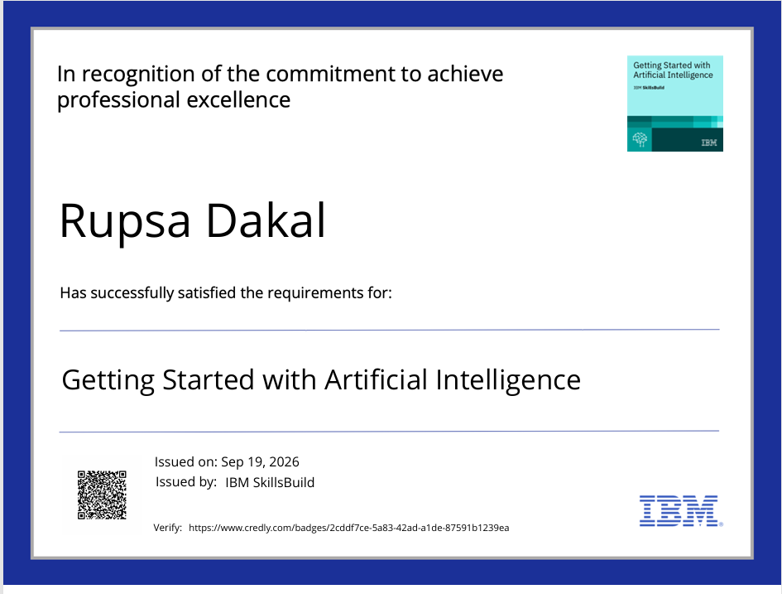

Slide 19
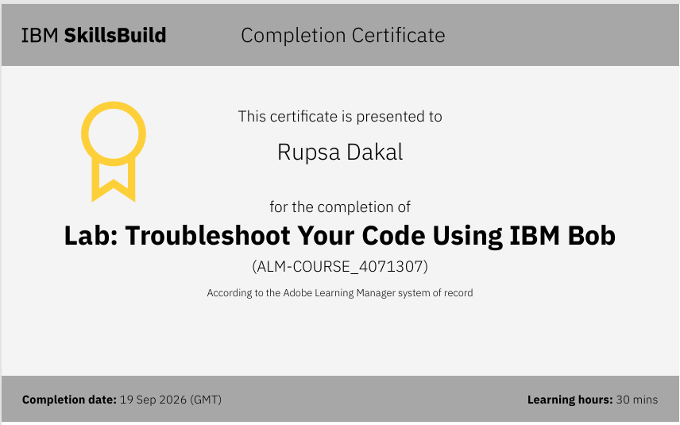

Slide 20
Conclusion
Conclusion
InterviewMate AI successfully demonstrates how IBM watsonx.ai and IBM Granite can be integrated into a real, working web application to solve a genuine problem faced by B.Tech students everywhere.
The platform delivers AI-generated interview questions, 7-dimension answer evaluation, and a progress dashboard — all backed by 175 automated tests and built with production-quality security practices.
The lightweight RAG pipeline proves that meaningful retrieval-augmented generation does not require heavyweight ML infrastructure — a keyword-scoring approach grounded in a well-structured knowledge base achieves genuine query-time retrieval in pure Python.
This project demonstrates the full software development lifecycle: problem identification, architecture design, implementation, security review, automated testing, and documentation.
What Was Built
Full-Stack
Flask App
7 URL Routes
IBM Granite
Real API
No fakes
RAG Pipeline
Pure Python
5 KB files
SQLite DB
2 Tables
Safe Migration
175 Tests
100% Pass
Exit Code 0
InterviewMate AI | IBM watsonx.ai University Engagement
Notes:
Conclusion slide. Summarises the project achievement: real IBM Granite integration, RAG pipeline, 175 automated tests, full-stack web app with 7 routes, production security practices.

Slide 21
Thank You
InterviewMate AI – Your Personal AI Interview Trainer
IBM Granite | IBM watsonx.ai | Python Flask | SQLite | RAG | HTML / CSS / JS
B.Tech Information Technology | IBM University Engagement Program
Notes:
Thank you / closing slide.

